Slide 1


Introduction to data science
Course: Introduction to data science
Lecturers: Jonathan Schler, Naama Kopelman.
Names: Oz Wiess, Vlad Sadovnikov
ID: 205650047, 321744096

Slide 2



Intro to research
Research question
1. Can we predict how much views, likes or comments video on YouTube can get?
2. Which properties the videos have that makes them more popular?

Slide 3


Data sources
Data cleaning
Data set from Kaggle
Find how much ‘nun’ we have,
check all the data set has the same formats
Trending YouTube Video Statistics
Outliners handling

Slide 4



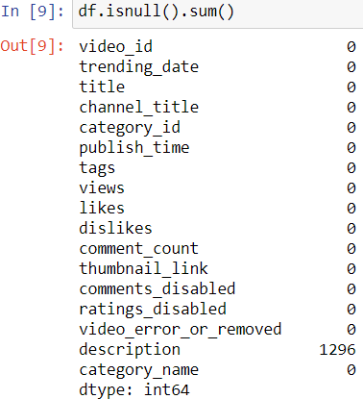
Missing data

Slide 5

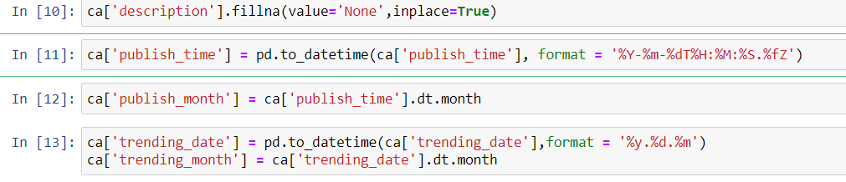
Formats of date and time

Slide 6

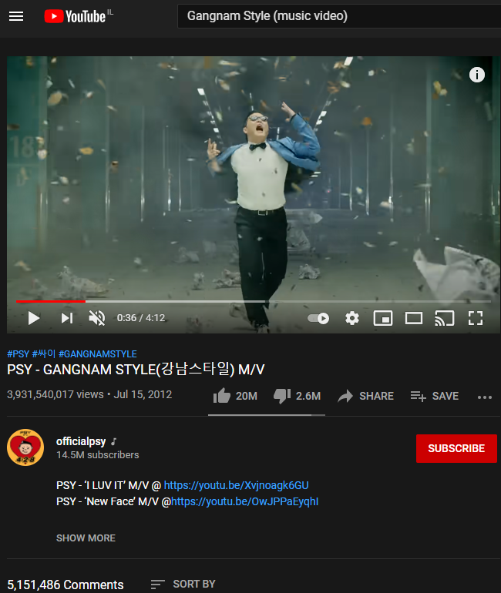


EDA
Gangnam Style:
First video over 1B views
Baby Shark:
Most viewed video today on YouTube.

Slide 7

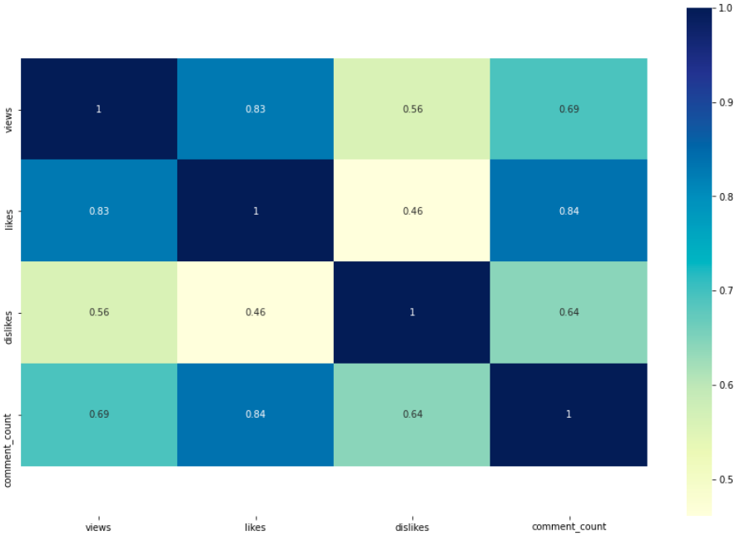
Most correlated parameters
Hight correlation:
+0.8
(likes:views) (likes:comment_count)
Medium correlation:
+0.6 (views:comment_count)

Slide 8
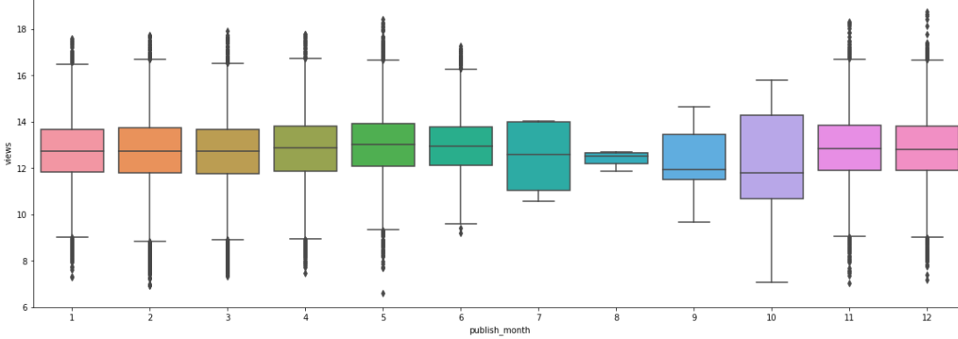
Marketing Funnel
Name: Boxplot that compares amount of views and month video published.
X-axis: publish month
Y-axis: views
Conclusion: there are more views on videos that published on August and October.
**compare between publish month and likes shows same results.

Slide 9
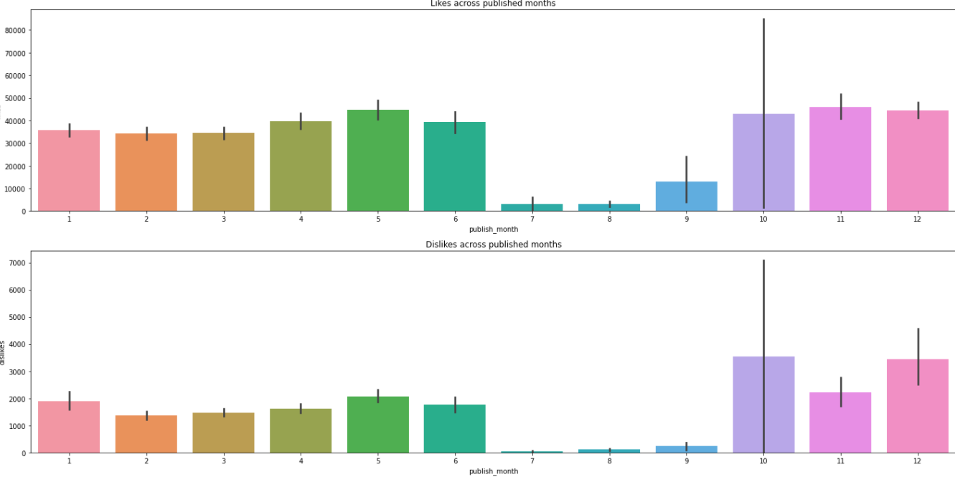
Amount of likes/dislikes by month
Name: Barplot that compares amount of likes/dislikes and month video published.
X-axis: publish month
Y-axis: likes/dislikes
Conclusion: easy to see that July, august and September have less activity in this compare.

Slide 10
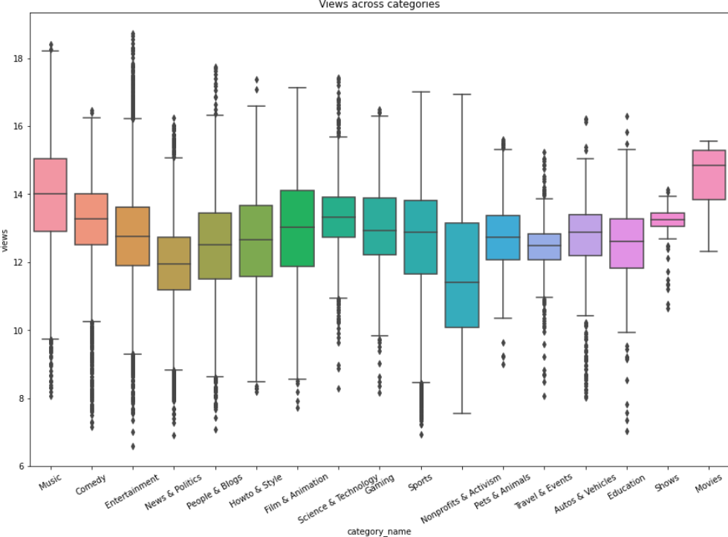
Amount of views per category
Name: Boxplot that compares amount of views and category of video.
X-axis: category
Y-axis: views
Conclusion: music and movies are most viewed videos on YouTube.

Slide 11


Positive & Negatives
Some of the positives of YouTube are:
Educational Value
Ability to display user created content
Some of the Negatives are:
Violence
Drugs

Slide 12
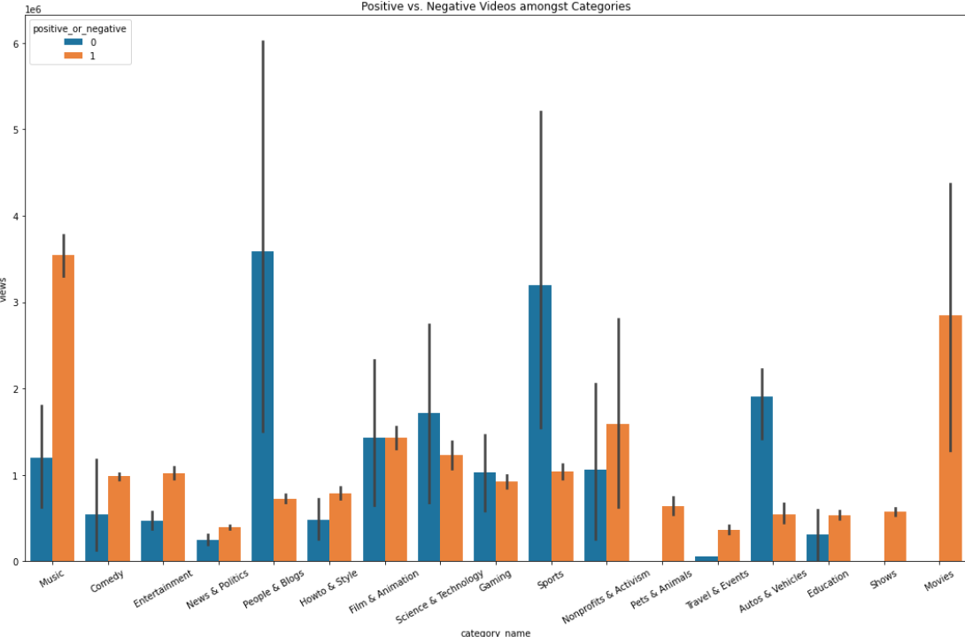
Positive or negative?
Name: Barplot that compares positive and negative amongst categories.
X-axis: category
Y-axis: views
Conclusion: music and movie are the most popular videos although the have a lot of negative issues.

Slide 13
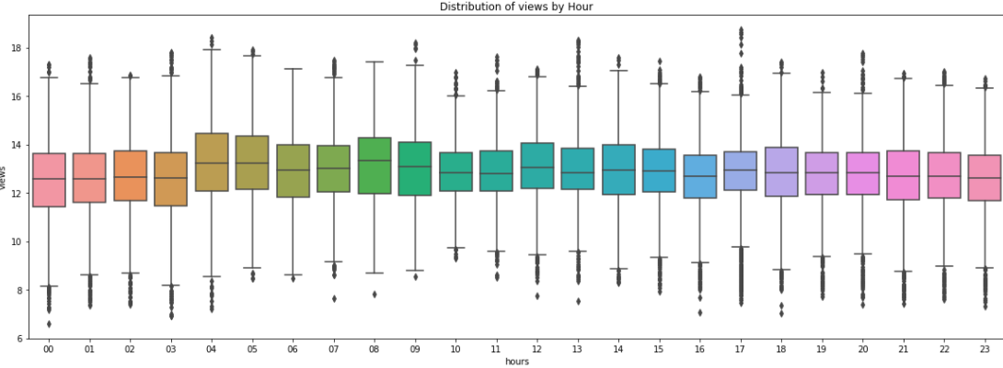
Time against popularity of video
Name: Boxplot that compares amount of views and hour video published.
X-axis: publish hour
Y-axis: views
Conclusion: not matter the hour of publishing the video.
**compare between publish month and likes shows same results.

Slide 14

Machine Learning
Of
Views

Slide 15


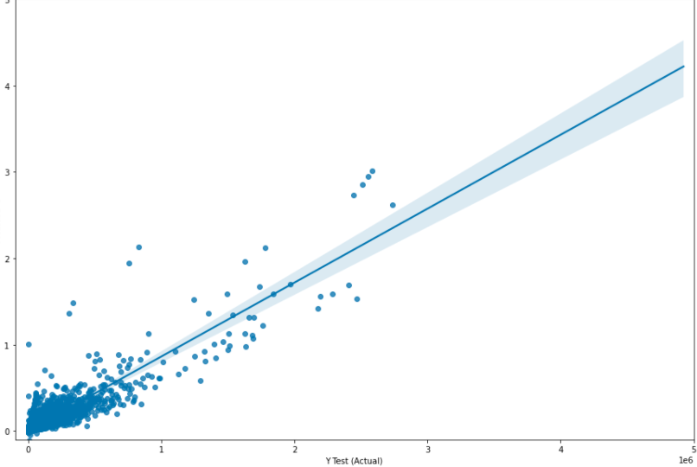
Linear regression
Using ‘sklearn’ library and liner regression we were able to train a model that predict the popularity/success of new uploaded video on YouTube.
The model predicted that if we will based on likes, views and comments our r^2 will be 0.839..

